Slide 1
Kinematics
Md. Khalilur Rhaman

Slide 2
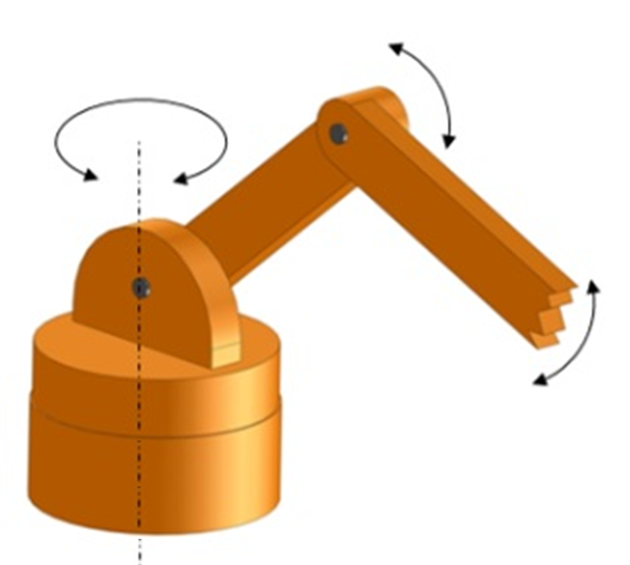
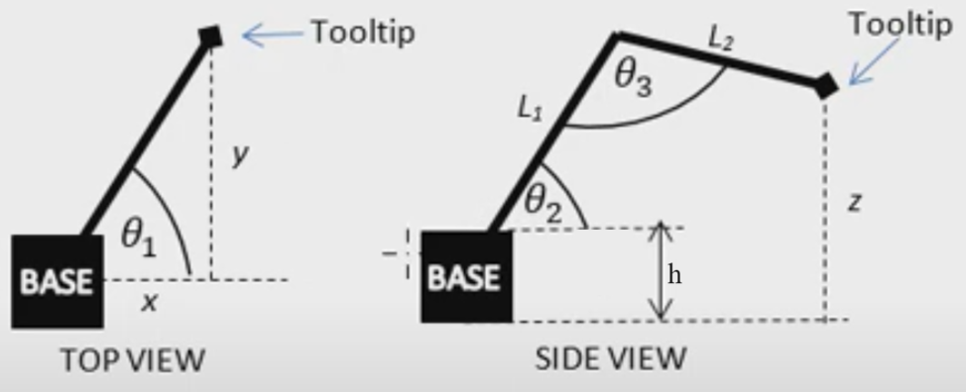
Forward Kinematics
https://www.youtube.com/watch?v=NRgNDlVtmz0

Slide 3
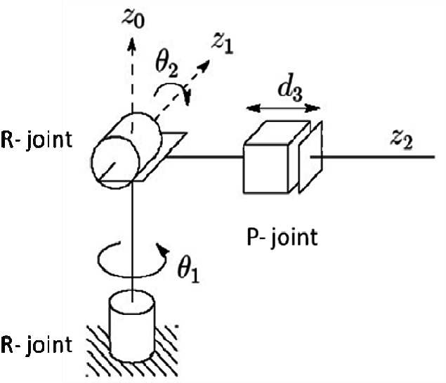
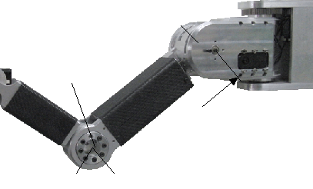
Type of Joint
Active Joint
Passive Joint
Revolute
Prismatic

Slide 4
Forward kinematics using trigonometry

Slide 5
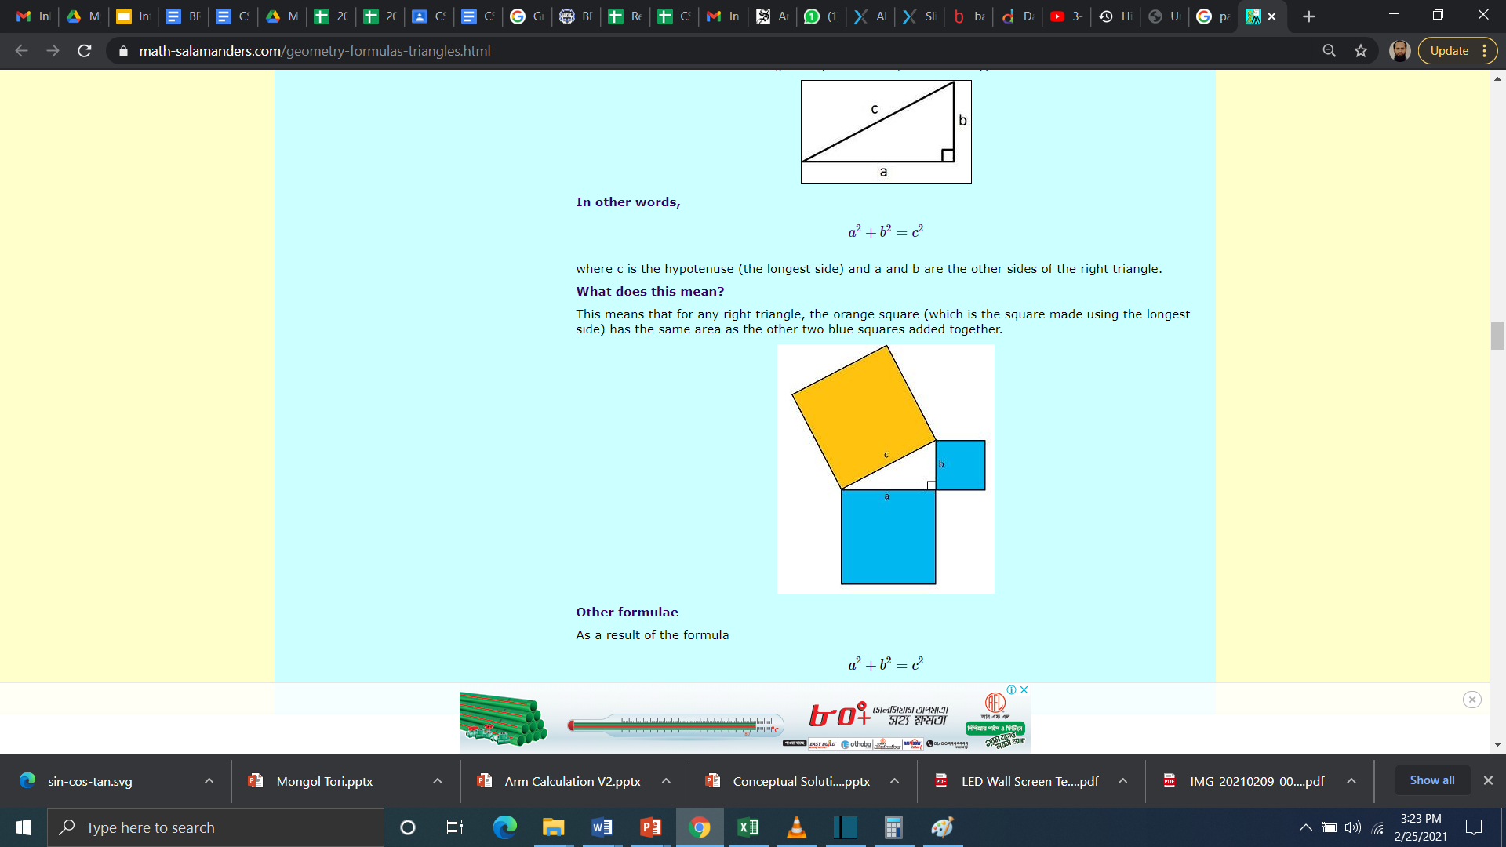
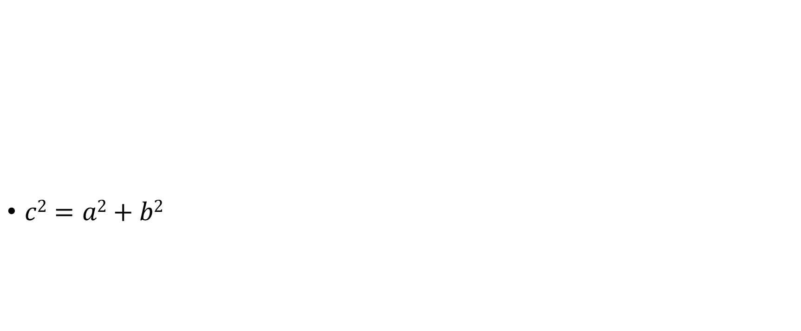
Pythagoras' Theorem for right triangle

Slide 6
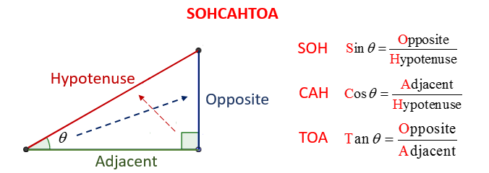
Basic Trigonometric Functions

Slide 7
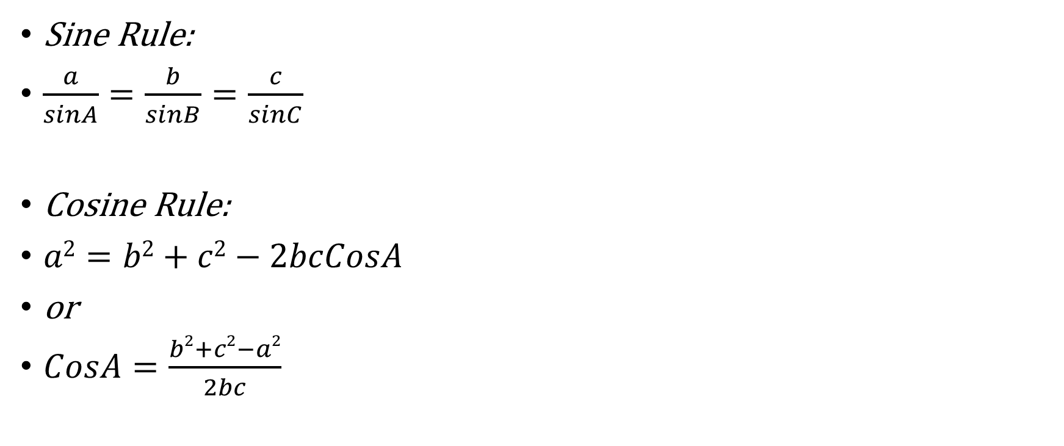
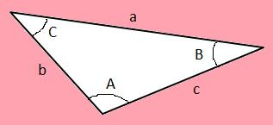
The Sine and Cosine Rules

Slide 8
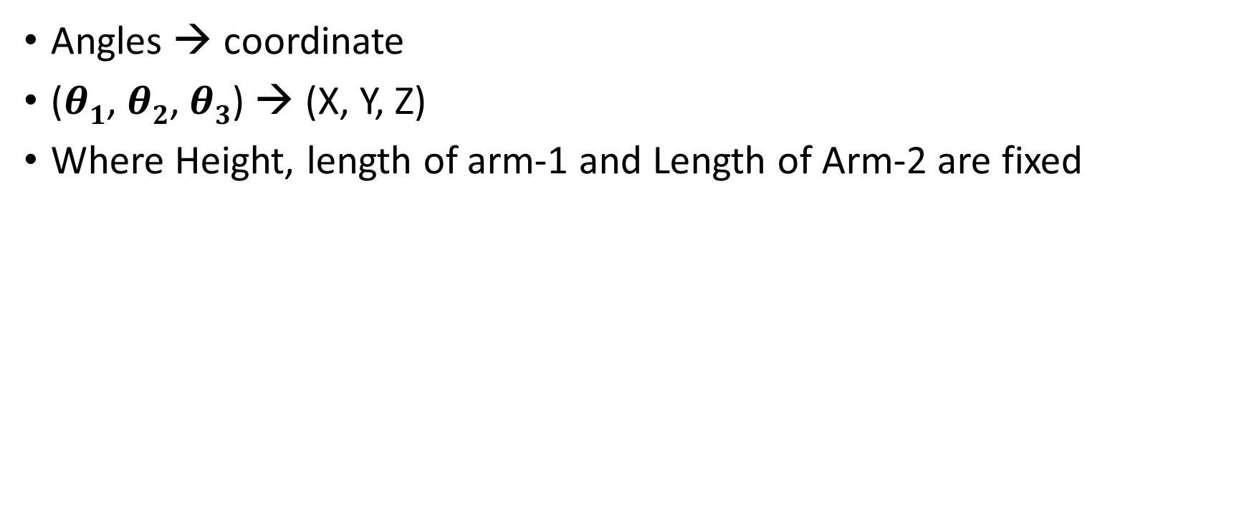
Forward Kinematics

Slide 9
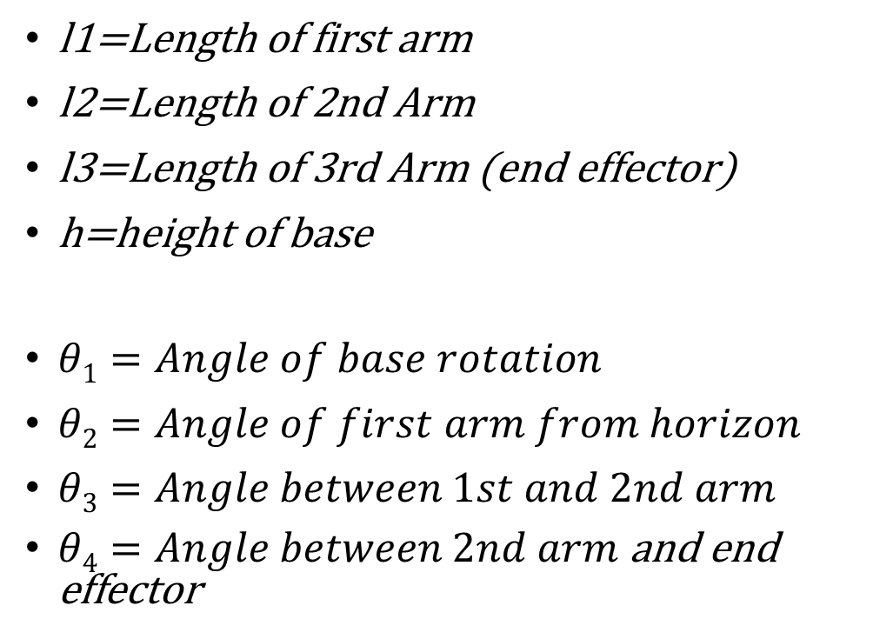












4 DOF Arm Calculation

Slide 10
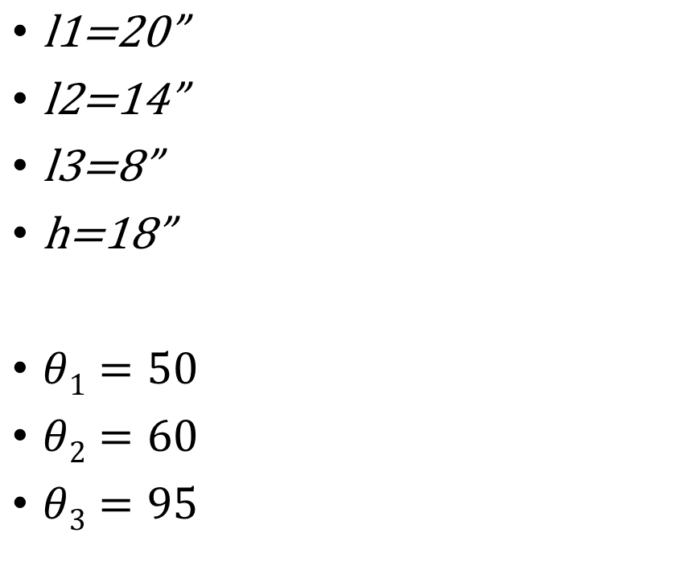


Example with a Value

Slide 11
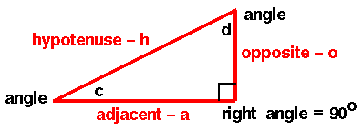

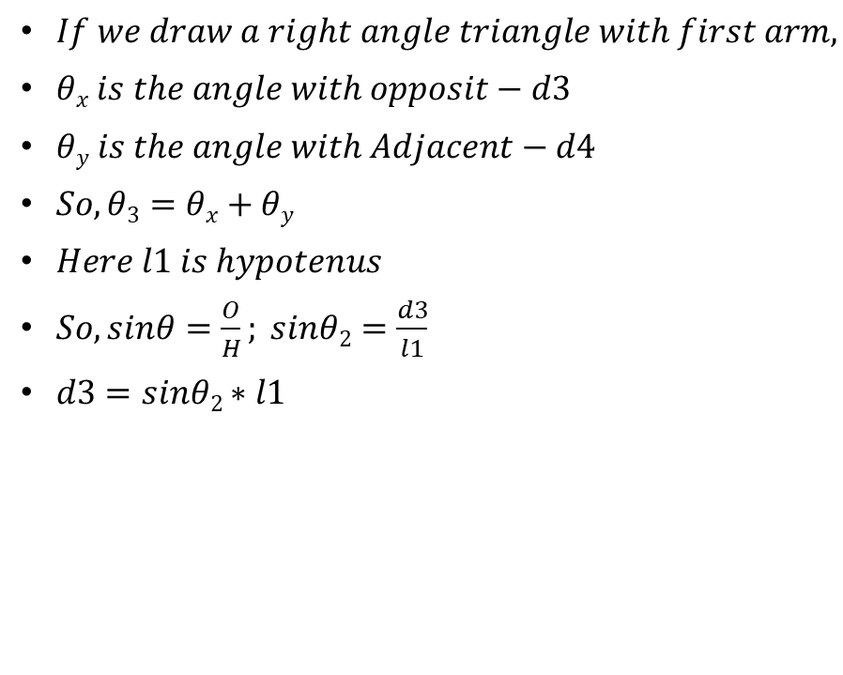











Forward Kinematics Calculation

Slide 12
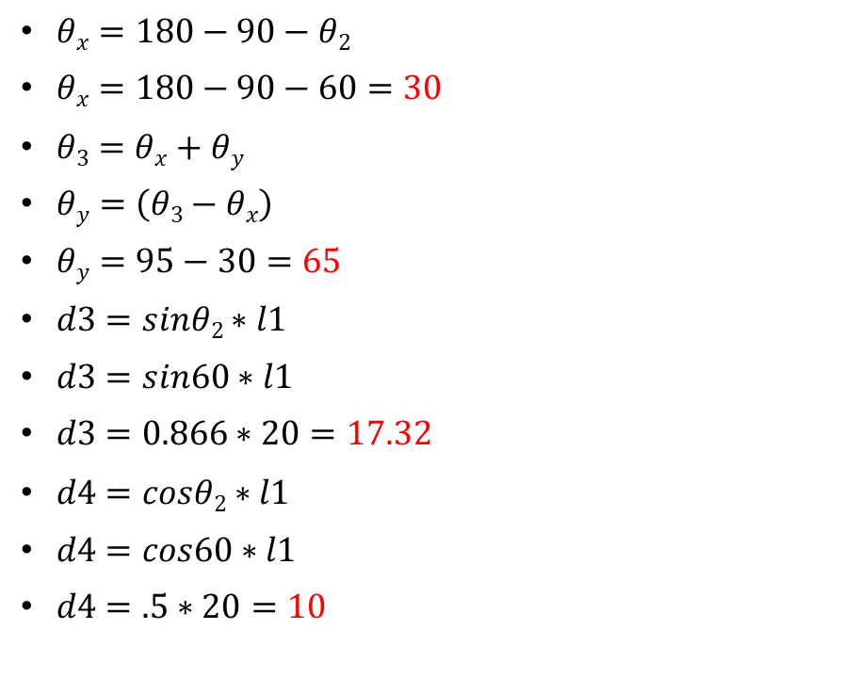






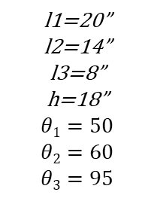
Example continuation…

Slide 13
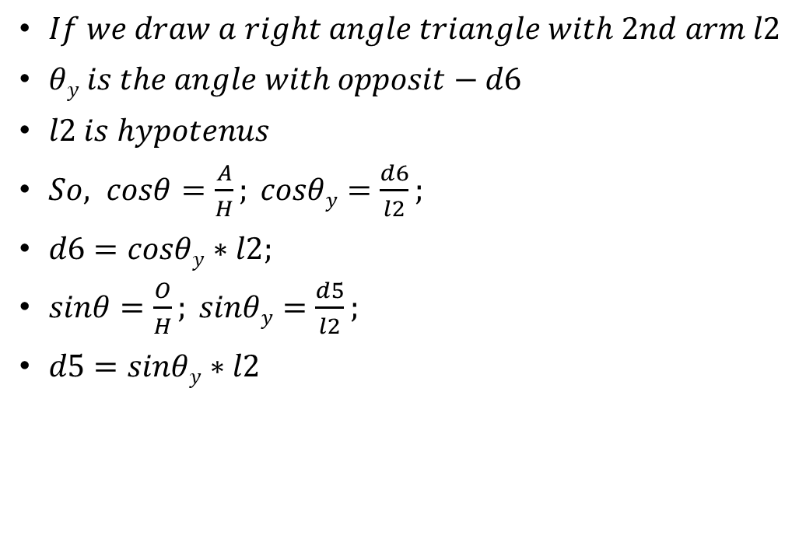




Forward Kinematics Calculation

Slide 14
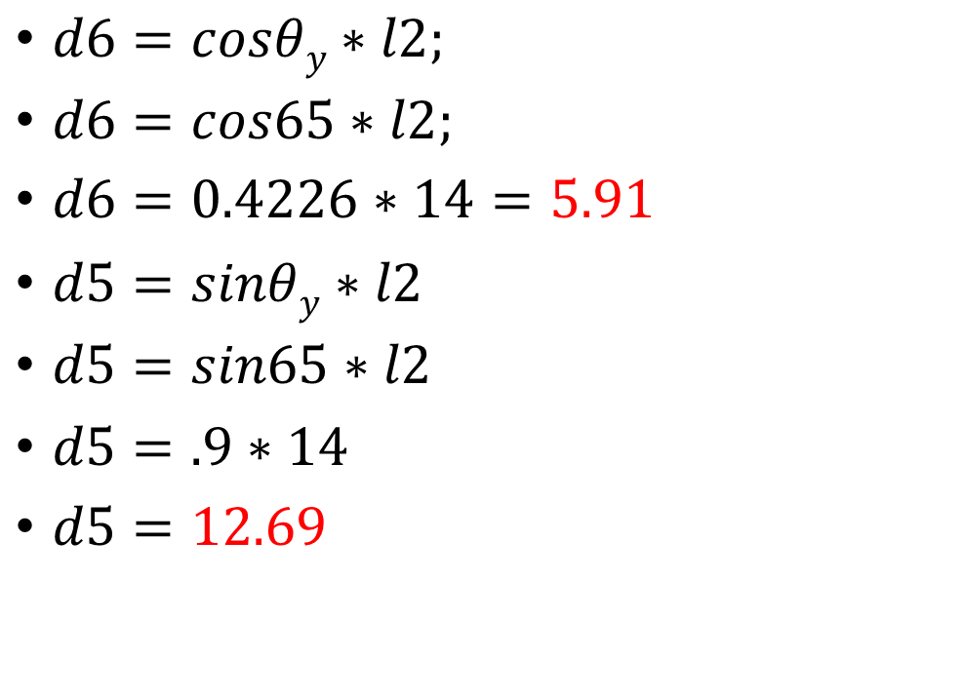


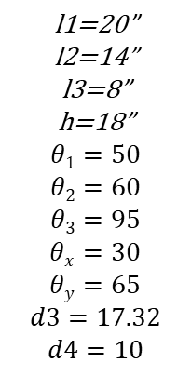
Example continuation…

Slide 15
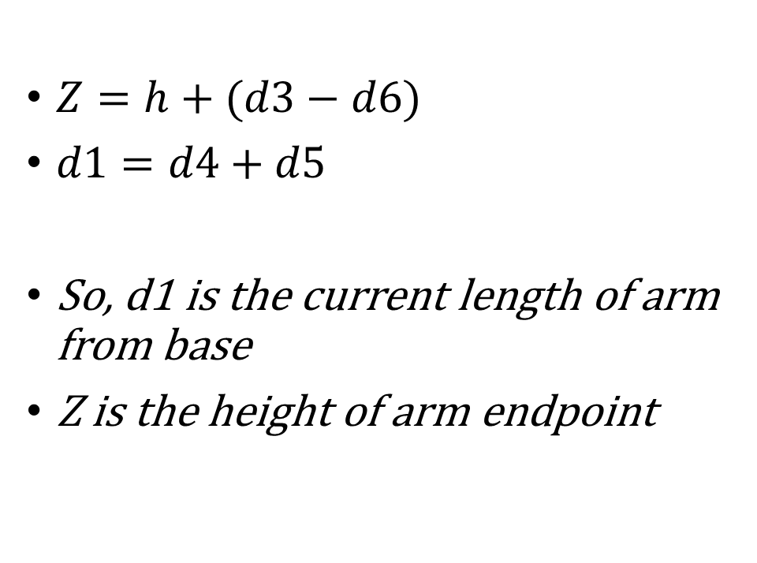






Forward Kinematics Calculation

Slide 16
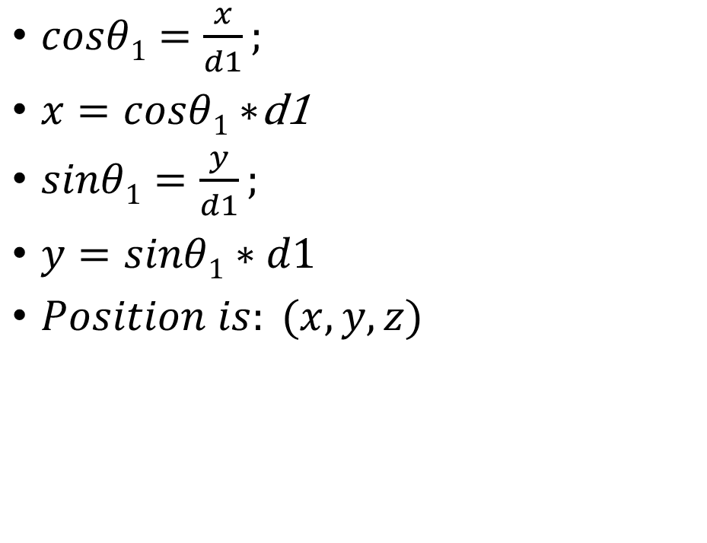







Now transform from top view

Slide 17
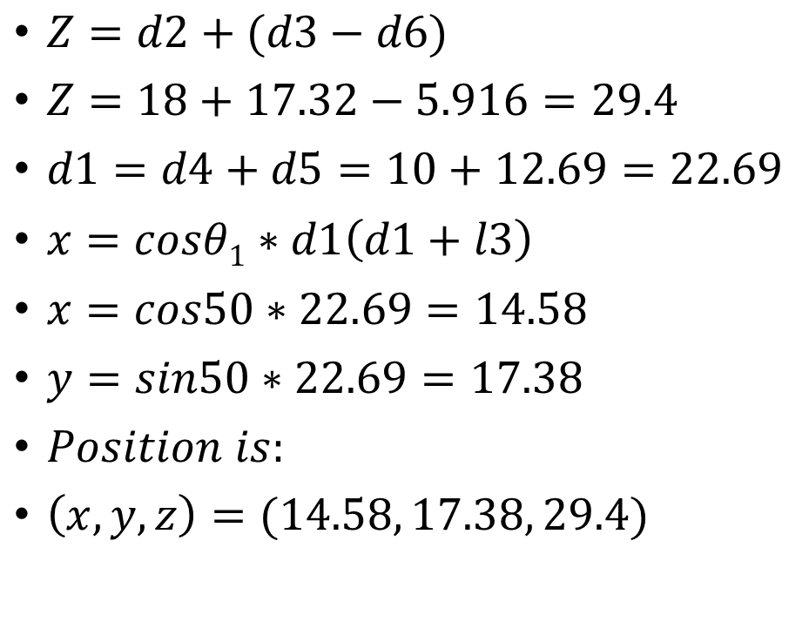
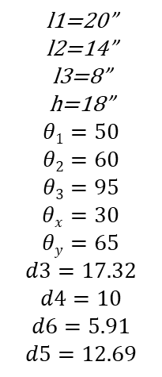
Example continuation…

Slide 18
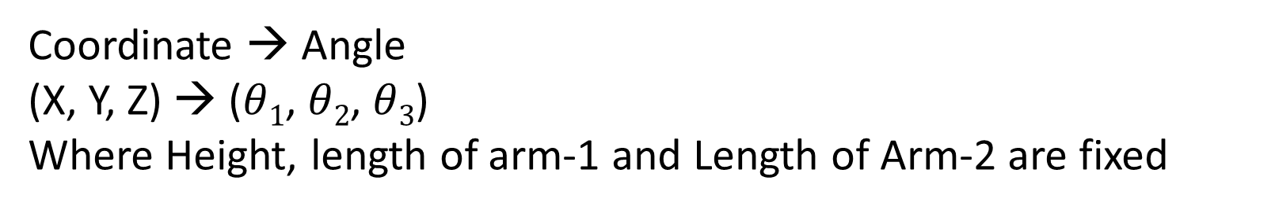
Inverse or Reverse kinematics using trigonometry

Slide 19
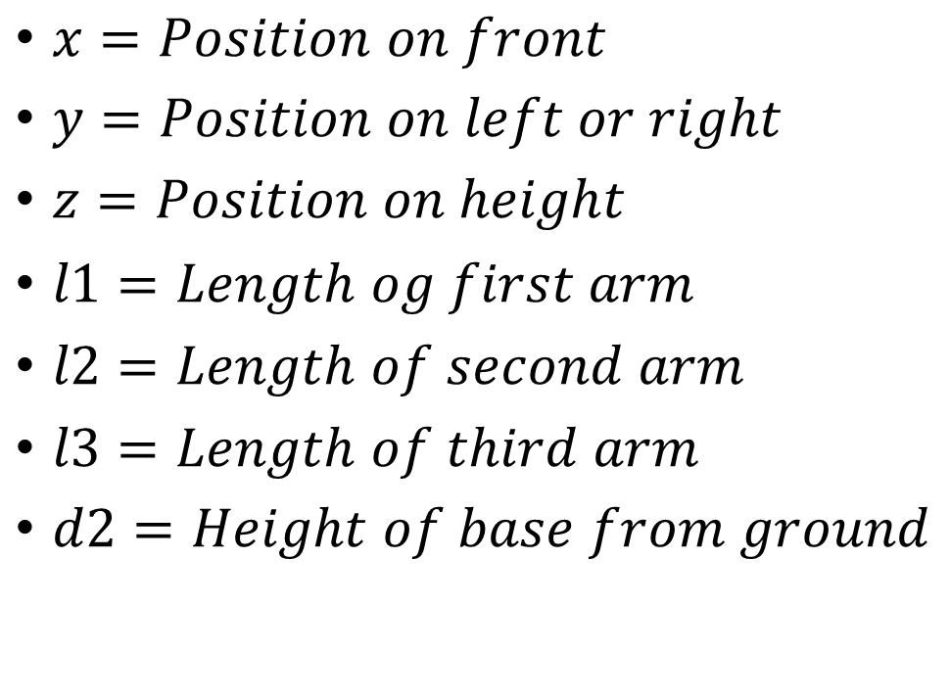






Reverse Kinematics (coordinate to angle)
(X, Y, Z)

Slide 20
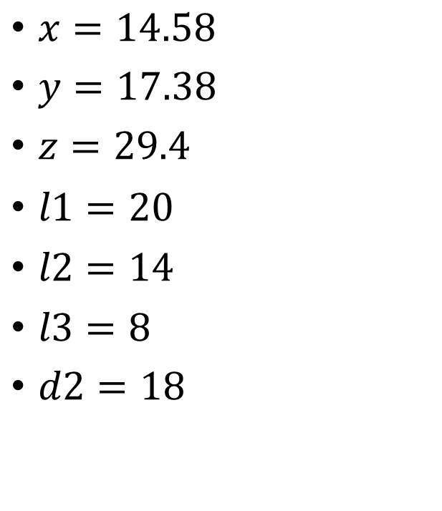



Reverse Kinematics Example value
(X, Y, Z)

Slide 21
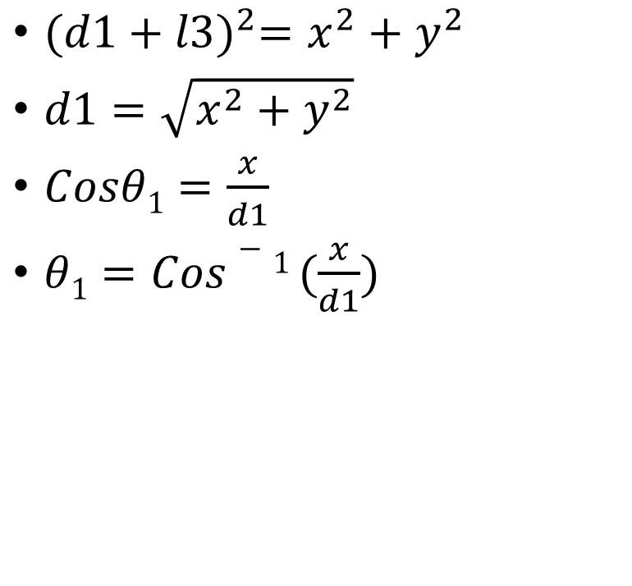


Reverse Kinematics

Slide 22
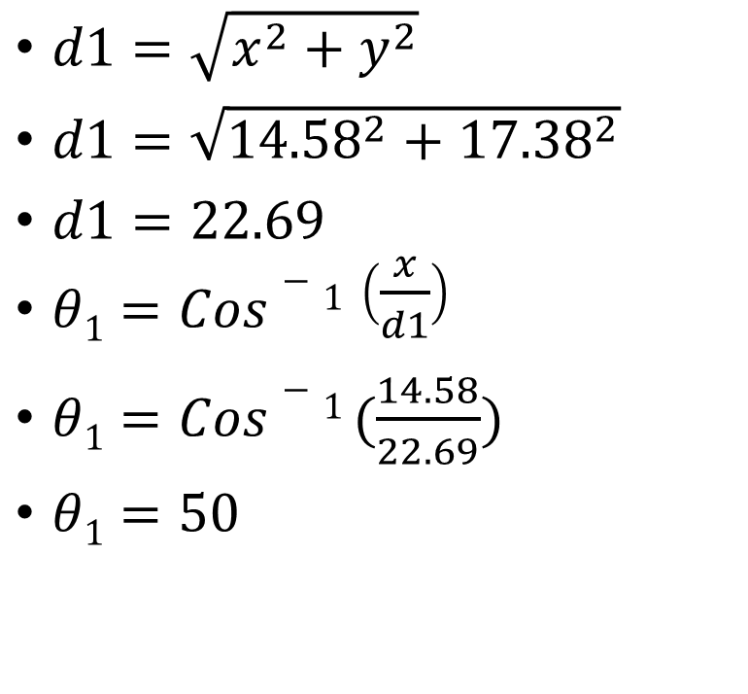
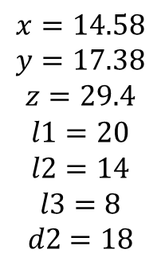
Example continuation…

Slide 23
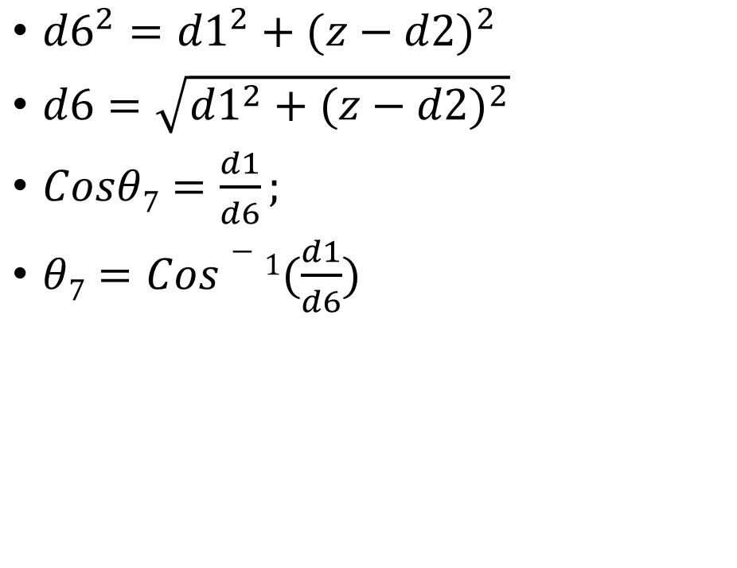








Reverse Kinematics

Slide 24
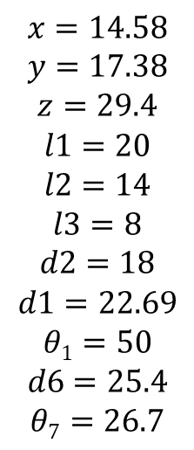
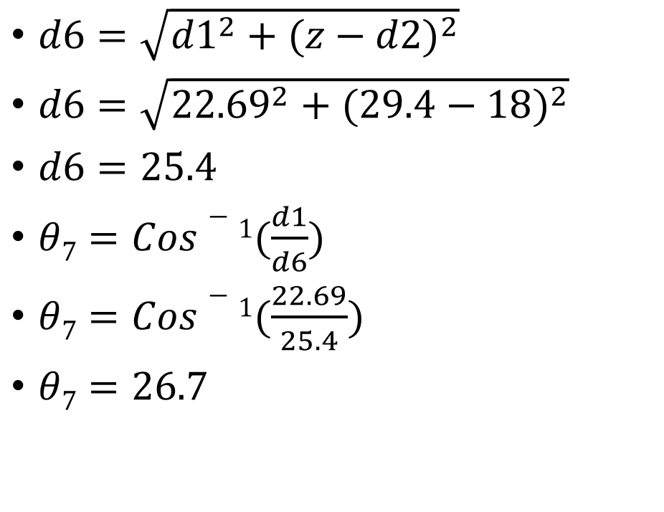
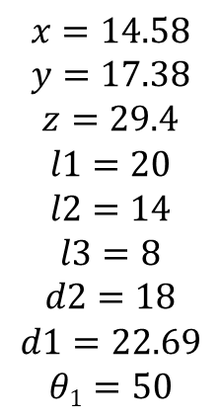

Example continuation…

Slide 25






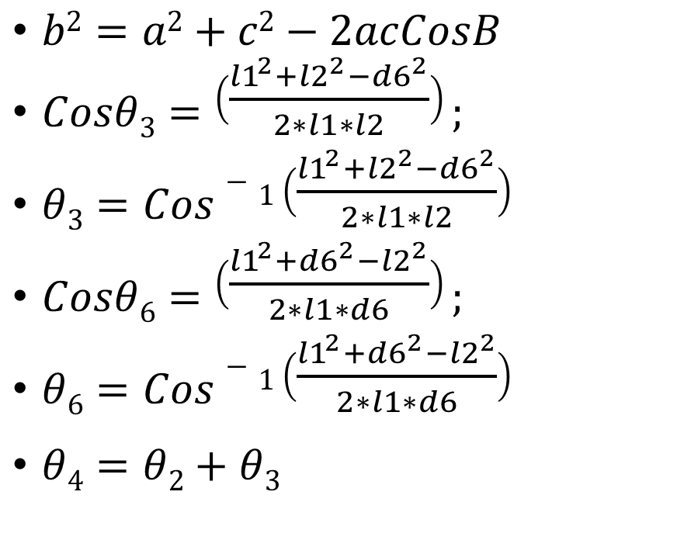
Reverse Kinematics

Slide 26
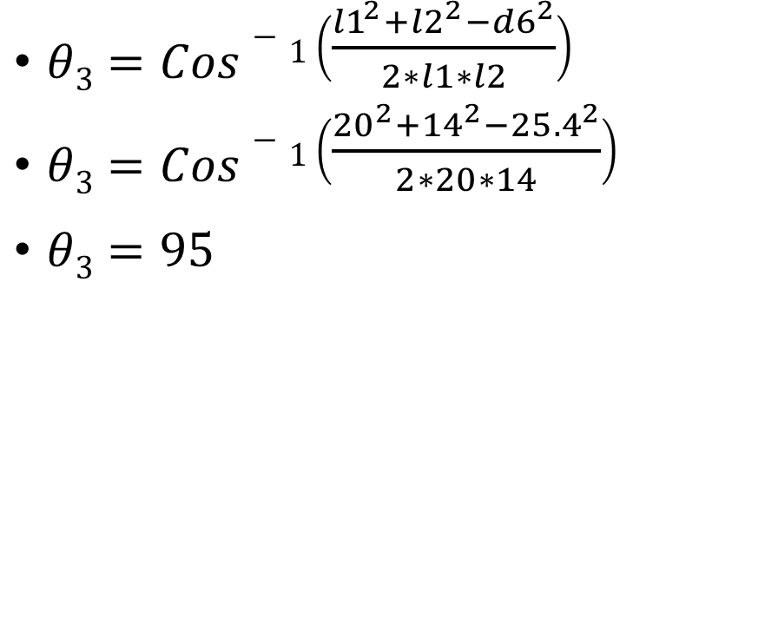
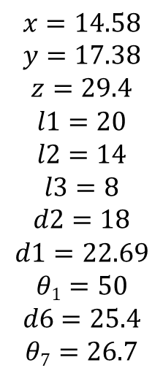
Example continuation…

Slide 27
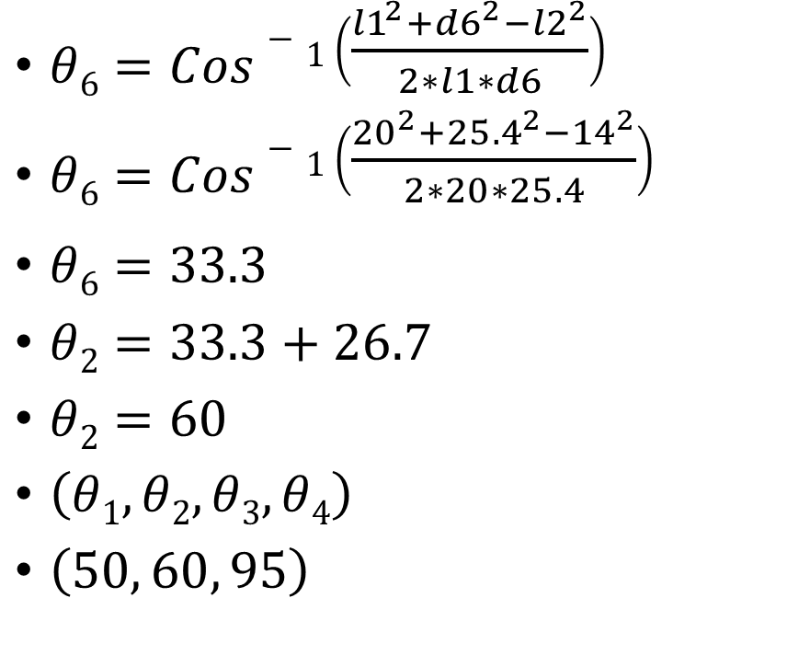
Example continuation…

Slide 28
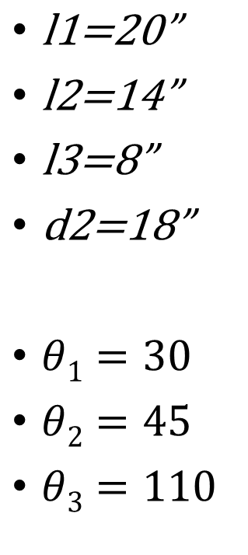
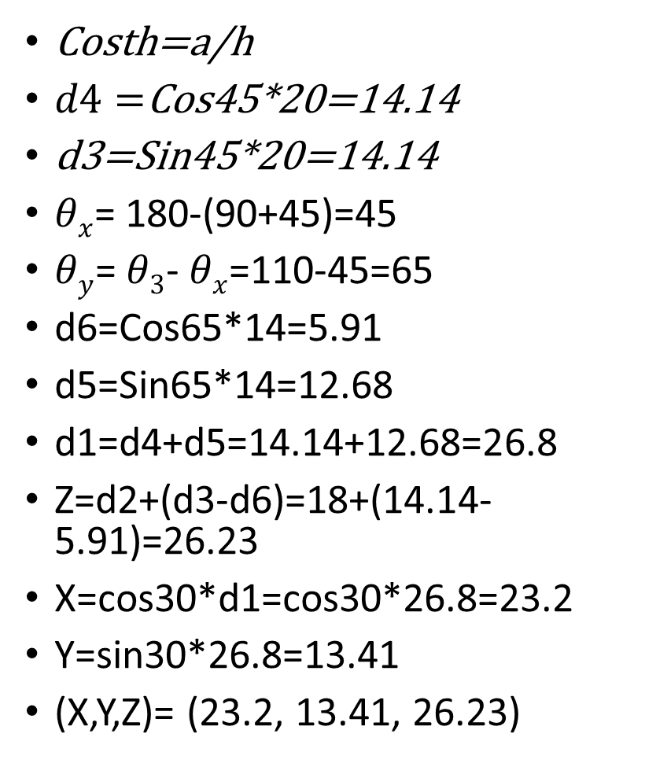
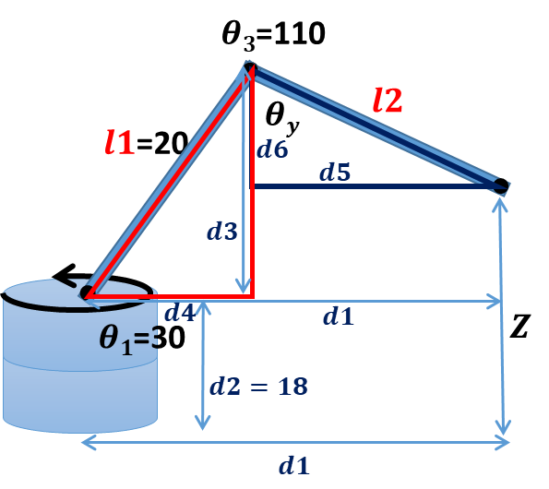
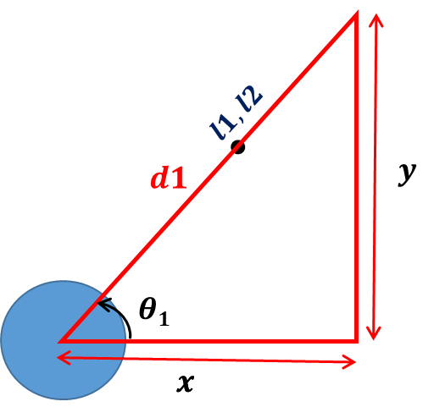
Example-2

Slide 29
End of Forward and Inverse Kinematics using trigonometry
https://www.youtube.com/watch?v=1-FJhmey7vk

Slide 30
Forward kinematics using DH parameter and Homogeneous transformation matrix

Slide 31
Forward Kinematics
Forward kinematics refers to process of obtaining position and velocity of end effector, given the known joint angles and angular velocities.
For example, if shoulder and elbow joint angles are given for arm in sagittal plane, the goal is to find Cartesian coordinates of wrist/fist.

Slide 32
Forward Kinematics
https://www.youtube.com/watch?v=D3w3ZANOy3s

Slide 33
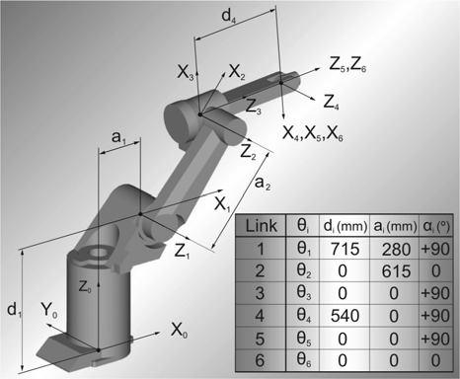
DH (Denavit-Hartenberg) parameters
DH parameters are used in robot manipulator to describe the axis orientations and arm lengths. The 4 DH parameters are called theta, d, alpha and a. DOF stands for degrees of freedom.

Slide 34




















Example
Joint 3
Joint 4
Joint 1
Joint 2
Joint 1 & 2
Joint 3
Joint 4

Slide 35
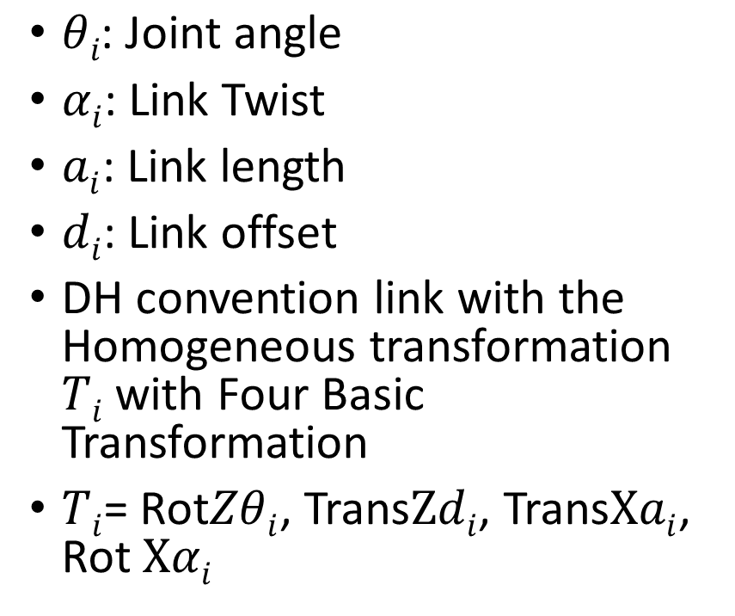
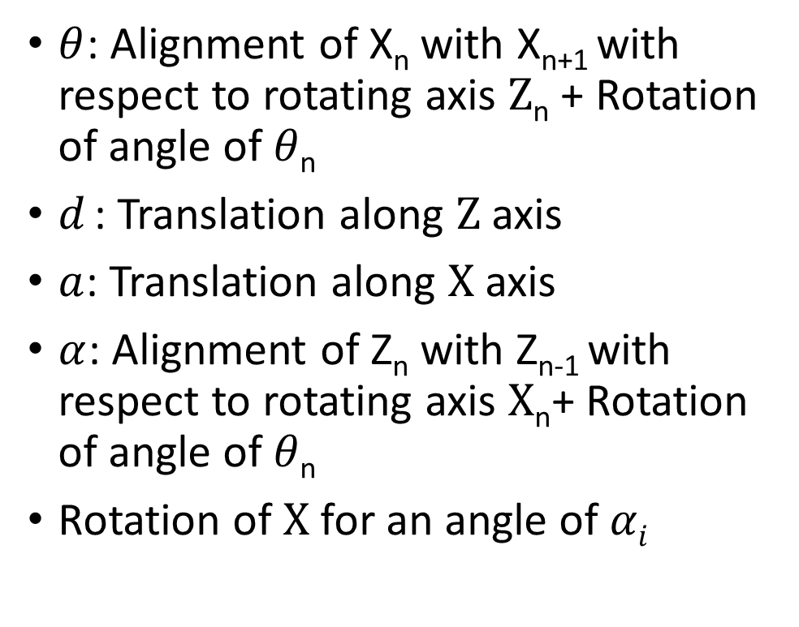
DH parameters calculation for two points

Slide 36

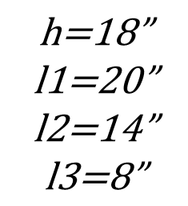
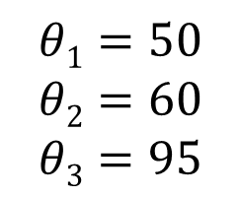




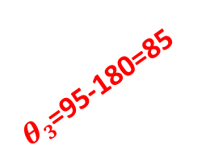


















Transform arm to find DH parameters
There are 4 frames in this arm

Slide 37


















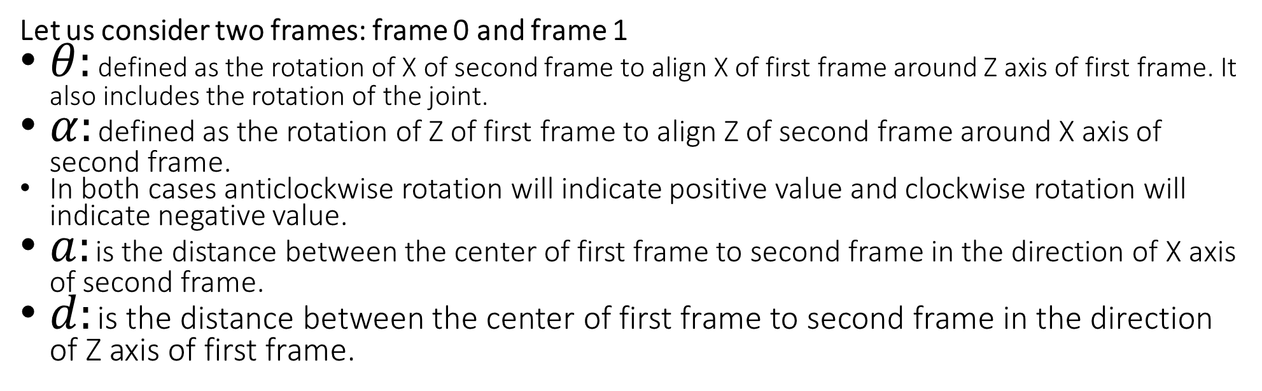
Example of DH parameters
Joint
1 | 0+50 | 90 | 0 | 18
2 | 0+60 | 0 | 20 | 0
3 | 0-85 | 0 | 14 | 0

Slide 38
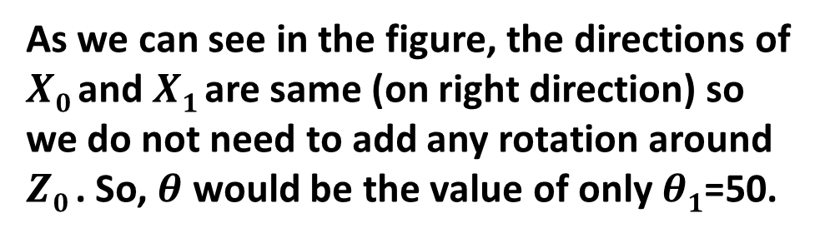
DH parameters of first Joint
Joint
1 | 0+50
2
3

Slide 39

DH parameters of first Joint
Joint
1 | 0+50 | 90
2
3

Slide 40
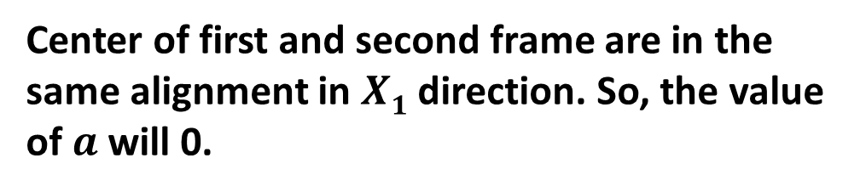
DH parameters of first Joint
Joint
1 | 0+50 | 90 | 0
2
3

Slide 41

DH parameters of first Joint
Joint
1 | 0+50 | 90 | 0 | 18
2
3

Slide 42

DH parameters of second Joint
Joint
1 | 0+50 | 90 | 0 | 18
2 | 0+60
3

Slide 43

DH parameters of second Joint
Joint
1 | 0+50 | 90 | 0 | 18
2 | 0+60 | 0
3

Slide 44

DH parameters of second Joint
Joint
1 | 0+50 | 90 | 0 | 18
2 | 0+60 | 0 | 20
3

Slide 45

DH parameters of second Joint
Joint
1 | 0+50 | 90 | 0 | 18
2 | 0+60 | 0 | 20 | 0
3

Slide 46

DH parameters of third Joint
Joint
1 | 0+50 | 90 | 0 | 18
2 | 0+60 | 0 | 20 | 0
3 | 0-85

Slide 47

DH parameters of third Joint
Joint
1 | 0+50 | 90 | 0 | 18
2 | 0+60 | 0 | 20 | 0
3 | 0-85 | 0 | 14 | 0

Slide 48

DH parameters of third Joint
Joint
1 | 0+50 | 90 | 0 | 18
2 | 0+60 | 0 | 20 | 0
3 | 0-85 | 0 | 14 | 0

Slide 49

DH parameters of third Joint
Joint
1 | 0+50 | 90 | 0 | 18
2 | 0+60 | 0 | 20 | 0
3 | 0-85 | 0 | 14 | 0

Slide 50





Homogeneous transformation
Homogeneous transformation matrix will transform the axis of pint (x, z) from the (x2, z2) to (x1, z1)

Slide 51


Homogeneous transformation matrix

Slide 52







DH parameters to Homogeneous transformation

Slide 53


Type of joint
Passive Joint (No movement)
Active Joint
Revolute Joint (Rotation)
Prismatic Joint (Linear Shift)

Slide 54







Homogeneous transformation matrixes for all joints
Joint
1 | 0+50 | 90 | 0 | 18
2 | 0+60 | 0 | 20 | 0
3 | 0-85 | 0 | 14 | 0

Slide 55























Homogeneous transformation matrixes
Homogeneous transformation matrix 2
Homogeneous transformation matrix 1
Homogeneous transformation matrix 3
=
X
X

Slide 56

(X, Y, Z)= (14.584, 17.38, 29.404)

